Slide 1


MATCHMAIKERS
AI-powered impact recruitment
SHIFT 1
Zurich 4th Nov 2023

Slide 2











Match MAIkers is an AI-first recruitment platform that helps candidates, companies and associations debias the recruitment process and maximise DEI impact recruitment outcomes for refugees, immigrants and women / diverse genders.
Leverages AI
Minimises biases
Recruitment flexibility
DEI credibility & commitment
Successful & lasting recruitment results
Collaborative creation (Powercoders/women++)
Proud supporters of U.N. SDGs
Notes:
Today we interview the team behind this innovative application to find out about their recipe for success!

Slide 3


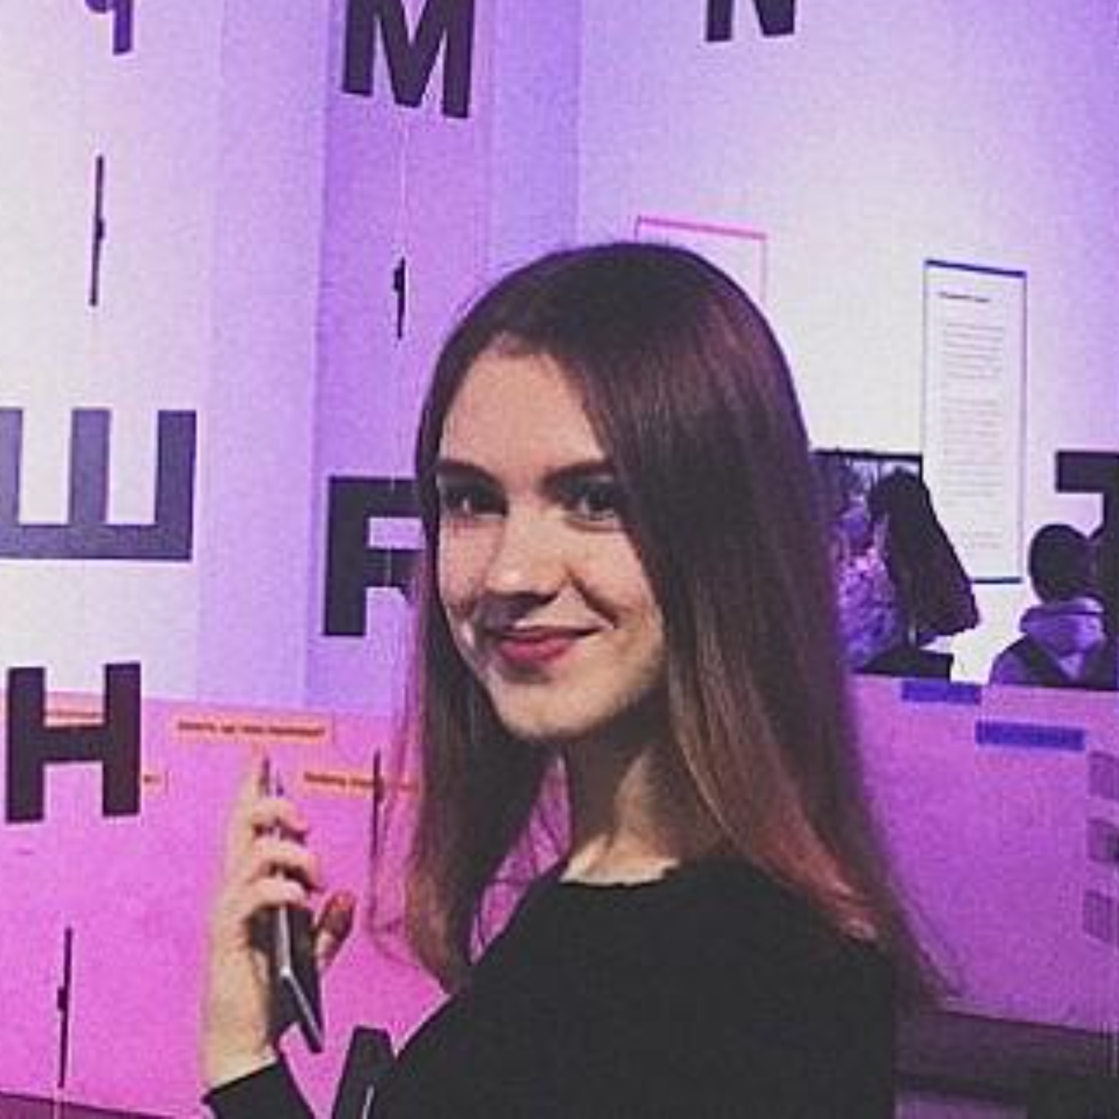

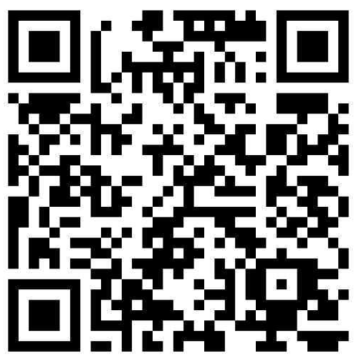

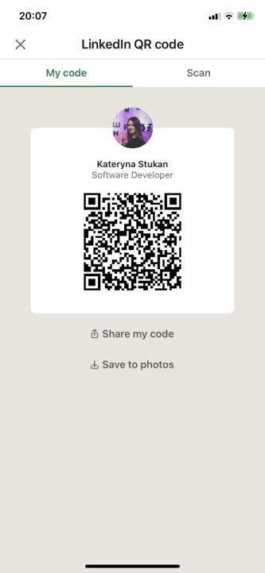








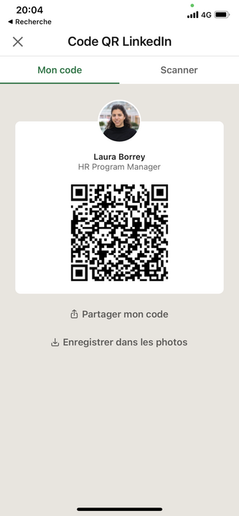




THE TEAM
Päivi Kero
Frontend Lead
🇫🇮
Elias Labarta
UX/UI
🇪🇸
Kateryna Stukan
Fullstack Deputy
🇺🇦
Majo Basgall
Data Science Lead
🇦🇷
Laura Borrell
Scrum Master
🇫🇷
Alicia Montoya
Project Manager
🇪🇸
Mauro Oliveri
Full Stack & Backend
Past participant

Slide 4
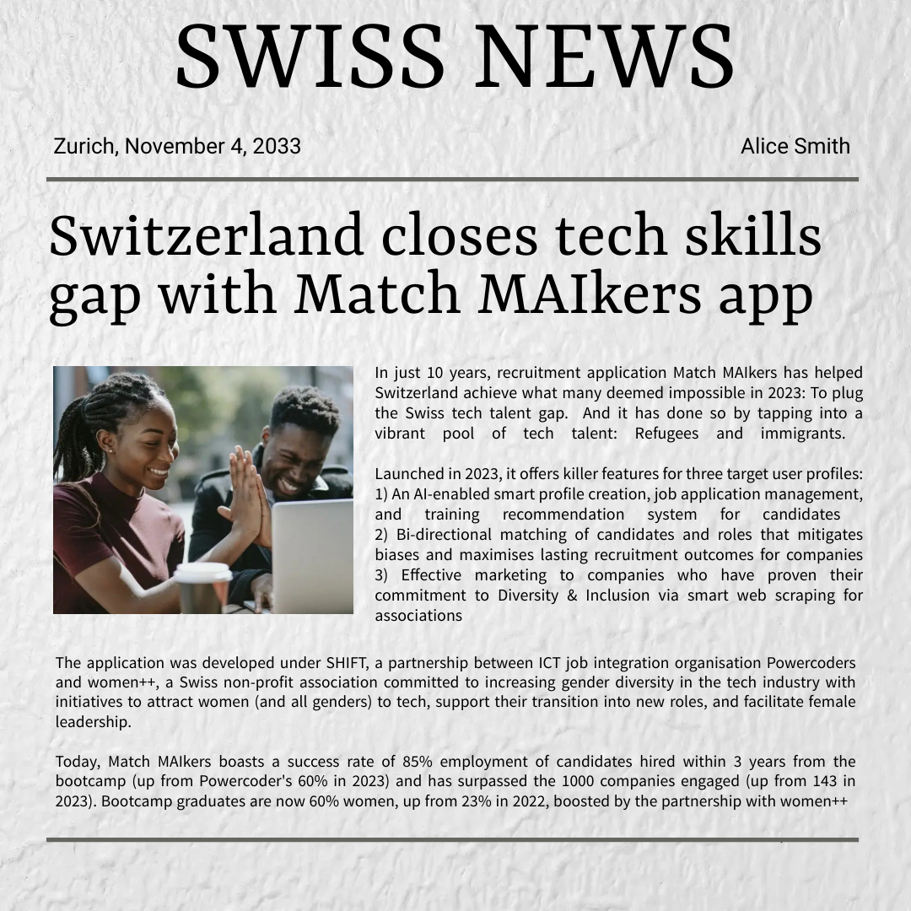

Slide 5


Slide 6



KILLER FEATURES FOR 3 USER PROFILES
Associations
Effective marketing to companies who have proven their commitment to Diversity & Inclusion via smart web scraping for associations
Company
Advanced bi-directional matching of candidates and roles that mitigates biases and maximises lasting recruitment outcomes for companies
Candidate
AI-enabled smart profile creation, job application management, and training recommendation system for candidates

Slide 7


ASSOCIATION
Key user needs
AI-enabled smart profile creation, job application management, and training recommendation system for candidates
Killer features
Effective marketing to companies who have proven their commitment to Diversity & Inclusion
Future AI-boosters & planned features
AI-powered web scraping feature to target credible companies with proven Diversity & Inclusion commitment to widen target company and job pool with jobs open to diverse tech talent.

Slide 8
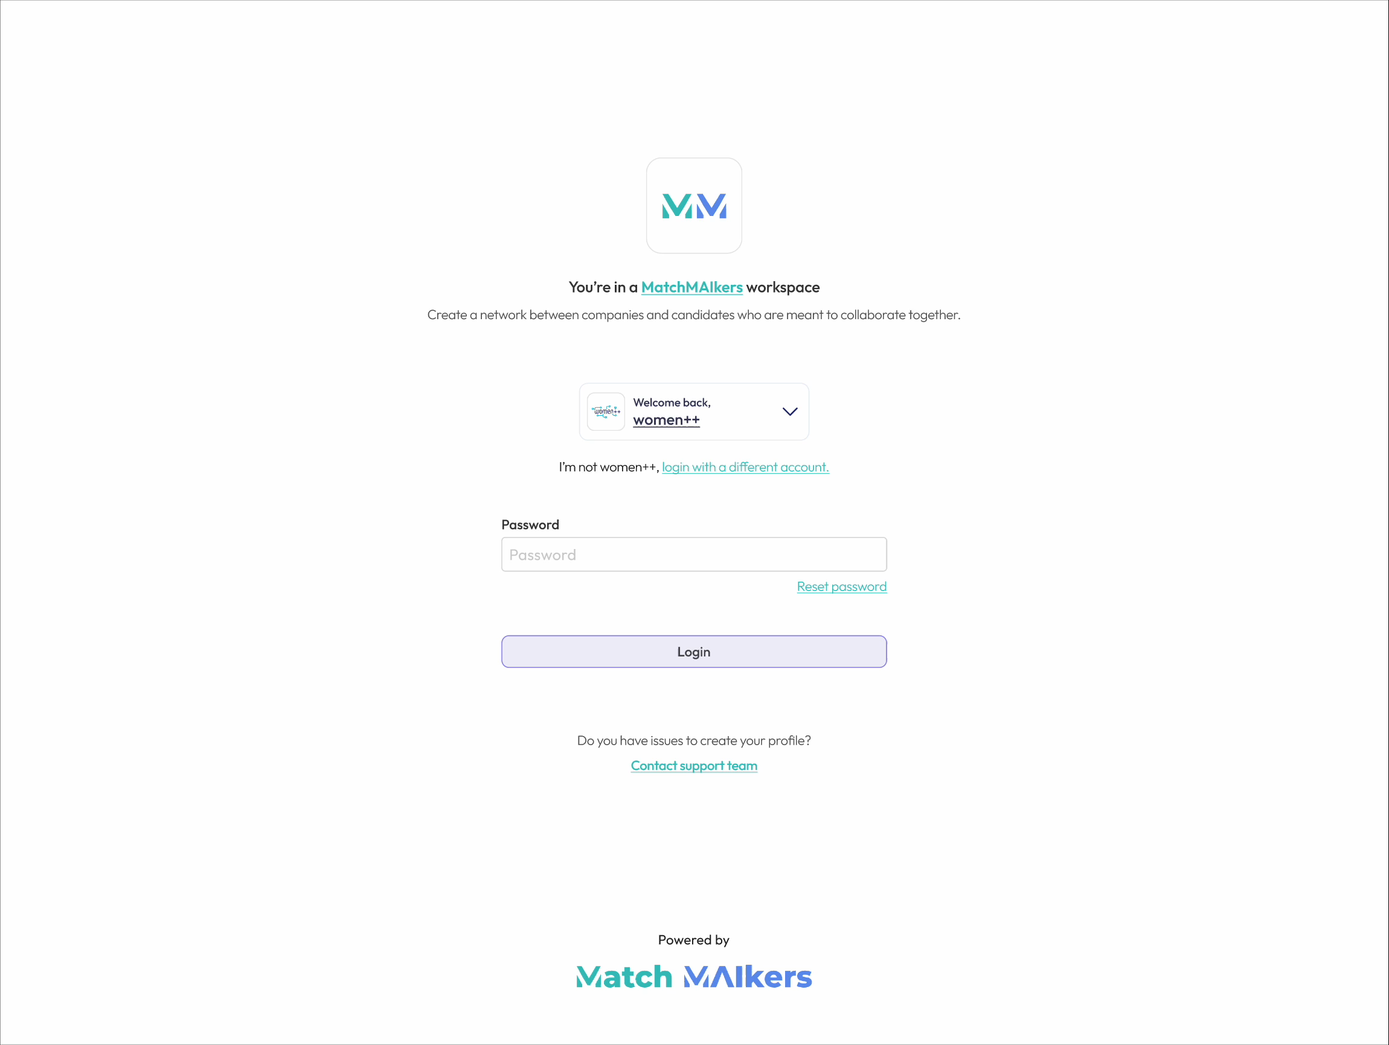
“Association invites new users to the platform (company and candidate)”

Slide 9
COMPANY
Key user needs
Easy company profile creation and maintenance, candidate search with filtering capabilities, candidate profile review and vetting per job ad, data privacy compliant platform
Killer features
Debiased job posting with optional masking of bias-sensitive fields
Candidate-matching with customized weightage of role requirements
Future AI-boosters & planned features
Conversational AI feature for (pending larger data sets):
Generated talent pool based on key words and search prompt “Hire software engineer”
Recommended actions for increased talent pool based on role, market, location
* Inspired by LinkedIn’s new “Recruiter 2024” feature launching soon
Notes:
* Inspired by LinkedIn’s new “Recruiter 2024” feature launching soon. Read more: Reimagining Hiring and Learning With the Power of AI | LinkedIn

Slide 10
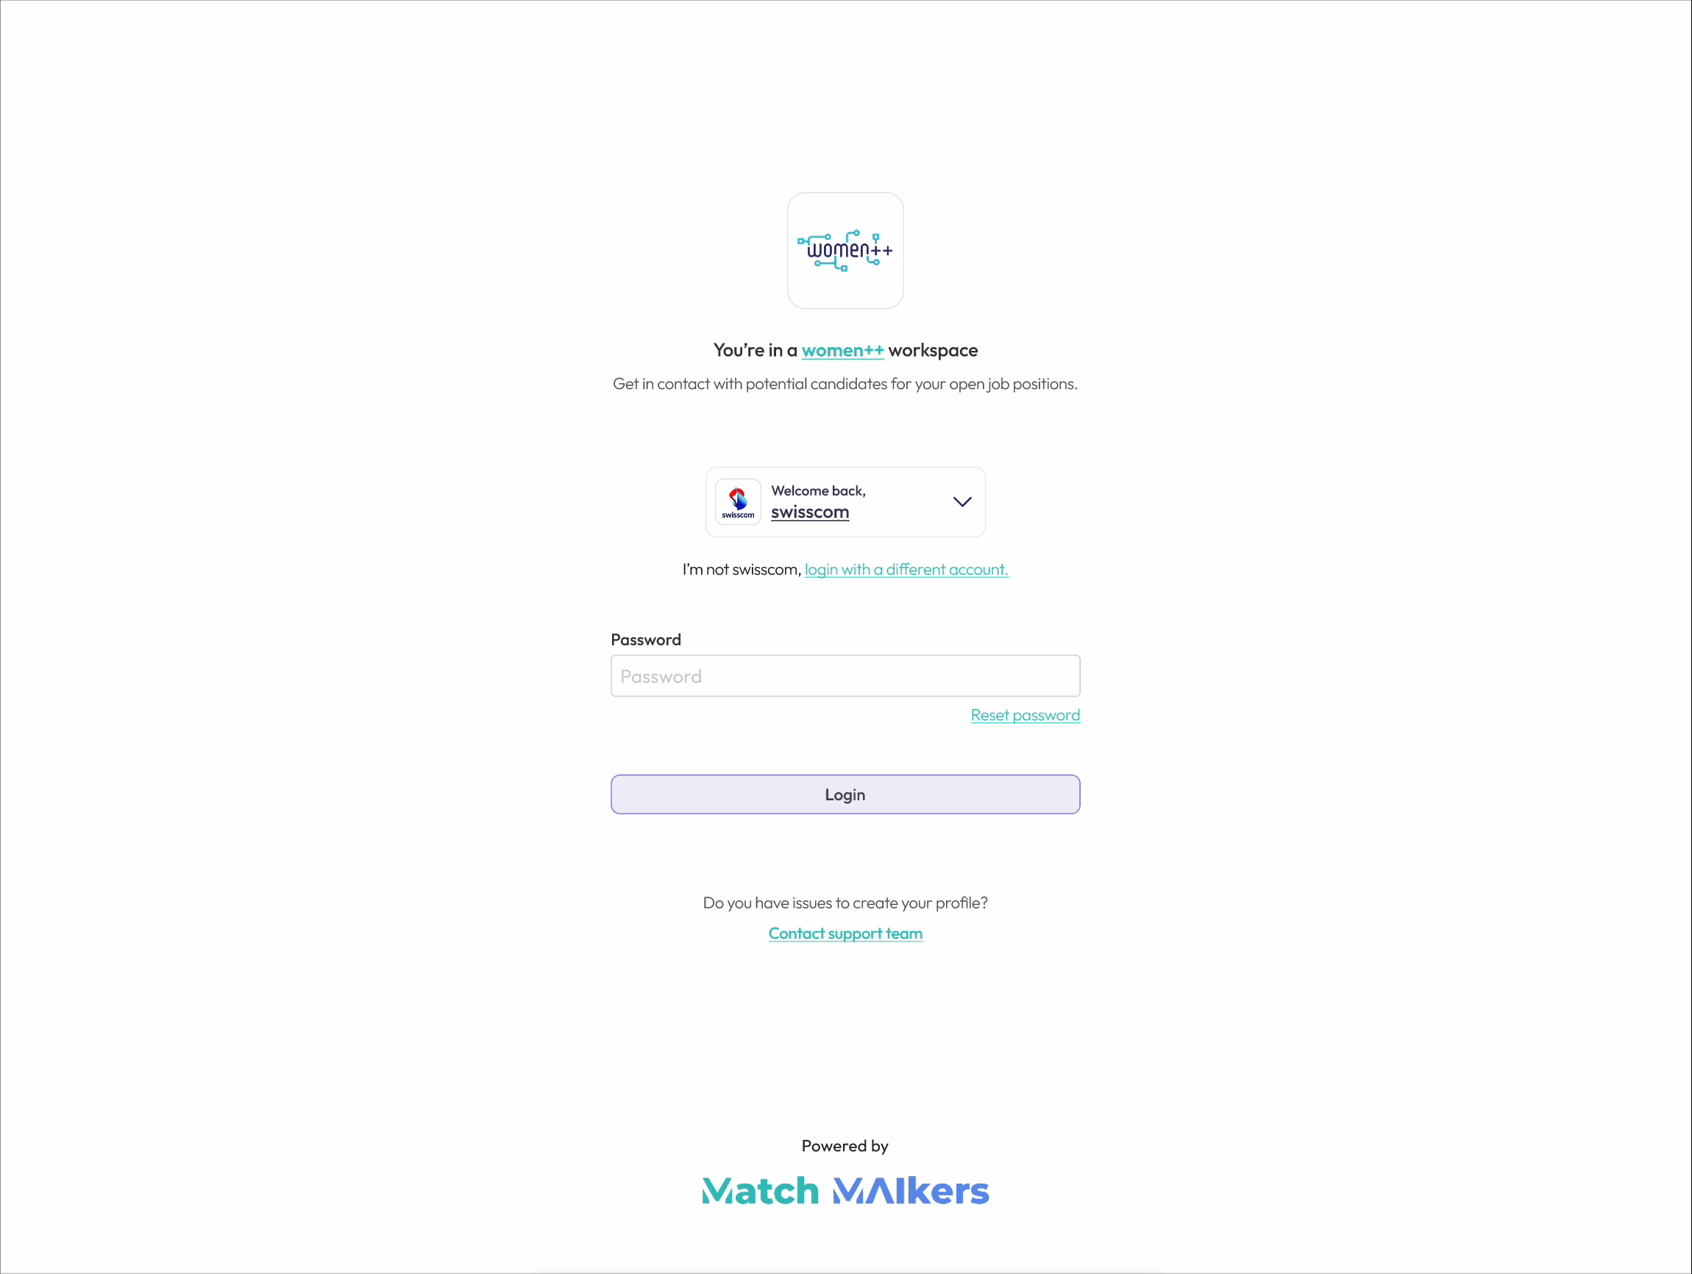
“Company posts a job and uses the Match me feature to find potential candidates"

Slide 11
CANDIDATE
Key user needs
Easy profile creation and maintenance, effective job application and tracking, data protection, credible & relevant companies suggested
Killer features: AI-powered:
Profile creation
Skill-based job matching
Values-based company-matching
Training recommendations for increased relevance
Future AI-boosters & planned features
AI-powered cover letter generator. Community hub for candidates to share feedback on companies, jobs, and transfer job-seeking knowledge and experiences

Slide 12
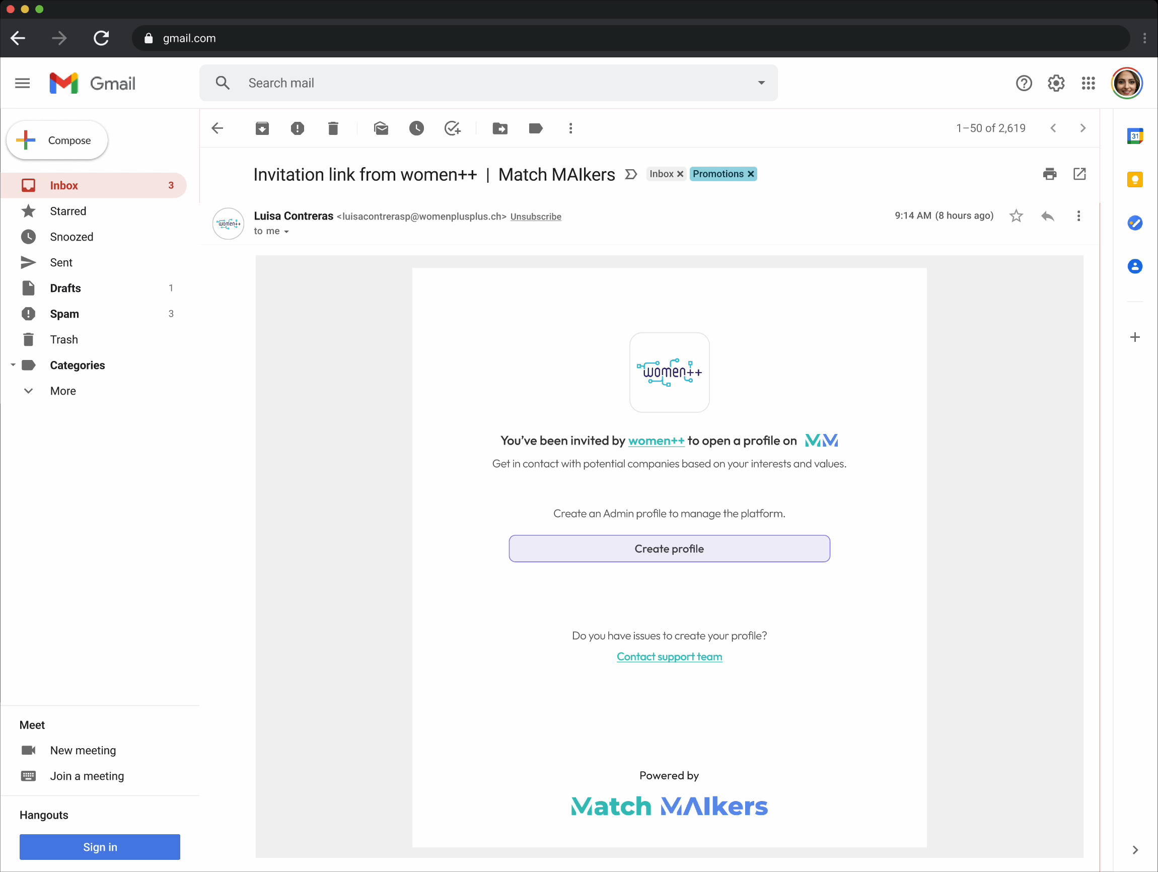
“Candidate opens a profile and uses the Match me feature to find a job"

Slide 13
Powered by

Slide 14
THE TEAM
Päivi Kero
Frontend Lead
🇫🇮
Elias Labarta
UX/UI
🇪🇸
Kateryna Stukan
Fullstack Deputy
🇺🇦
Majo Basgall
Data Science Lead
🇦🇷
Laura Borrell
Scrum Master
🇫🇷
Alicia Montoya
Project Manager
🇪🇸
Mauro Oliveri
Full Stack & Backend
Past participant

Slide 15
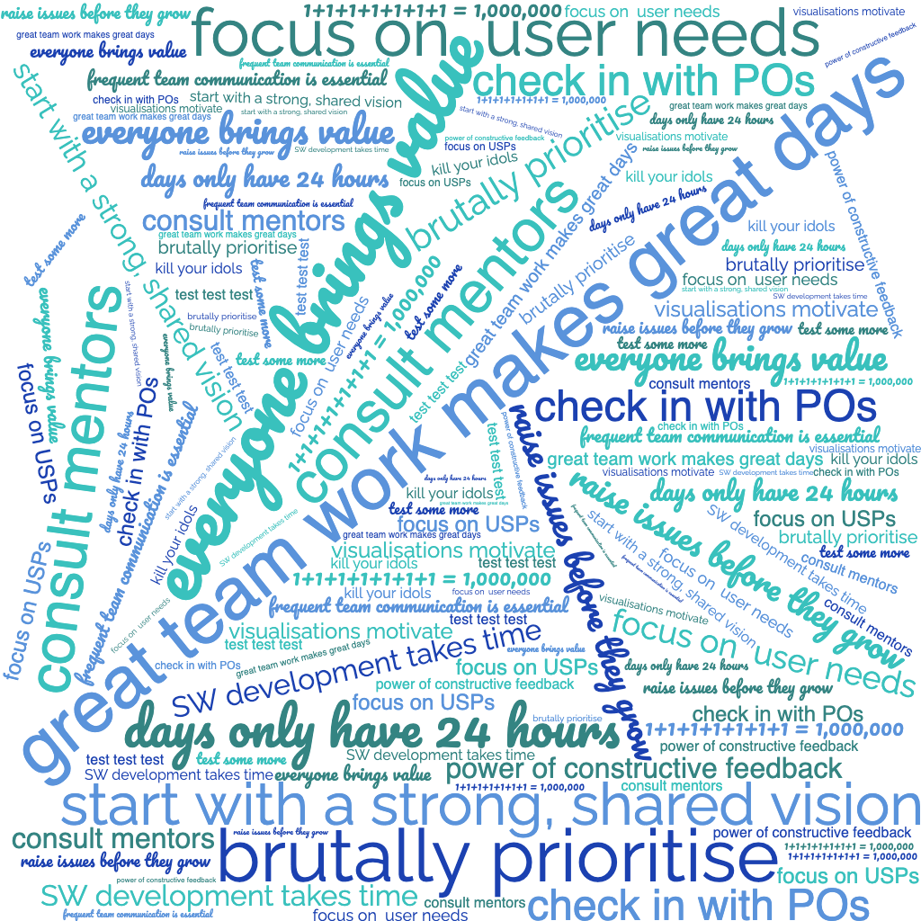
LEARNINGS

Slide 16
Powered by
aliciamontoya@hotmail.com
CONTACT US

